Slide 1







LAVENDER SWEET

Slide 2
Presentation Contents:
01
02
03
04
WHO ARE WE?
KEY POINTERS OF THE PROJECT
Website Features
INTRODUCTION
05
06
08
07
Execution Strategy
Project Development Process
Challenges &Solution
Conclusion

Slide 3
Introduction
In the modern world, online shopping is very popular. Lavender Sweet is a chocolate shop website that allows users to view products, see details, and buy chocolates online.
The main goals of this website are:
To make shopping for chocolates easy and convenient
To display all products with pictures, prices, and descriptions
To allow users to filter products by type or price
To provide a simple and attractive interface for a better user experience
This project helped me understand how to build a full website using HTML, CSS, PHP, and MySQL, and how to manage products and orders in a database.

Slide 4

Who are we?
Welcome to Lavender Sweet, a brand inspired by simple beauty, soft details, and the calming feel of lavender. Founded by Sara, Lavender Sweet was created to offer products that are simple, elegant, and made with care.
Each item is designed to bring comfort, charm, and a little touch of sophistication. At Lavender Sweet, we believe that small details can make everyday moments more special and beautiful.

Slide 5
Brand Identity:
Lavender Sweet is inspired by simplicity, elegance, and the calming feel of lavender.
Purpose:
To offer soft, beautiful, and carefully designed products that bring comfort and charm.
Target Audience:
People who appreciate simple, aesthetic, and calming designs.
Design Style:
Soft colors, clean layouts, and small details that create a peaceful look.
Products:
Items made with care, combining beauty with practical use
KEY POINTERS OF THE PROJECT:

Slide 6
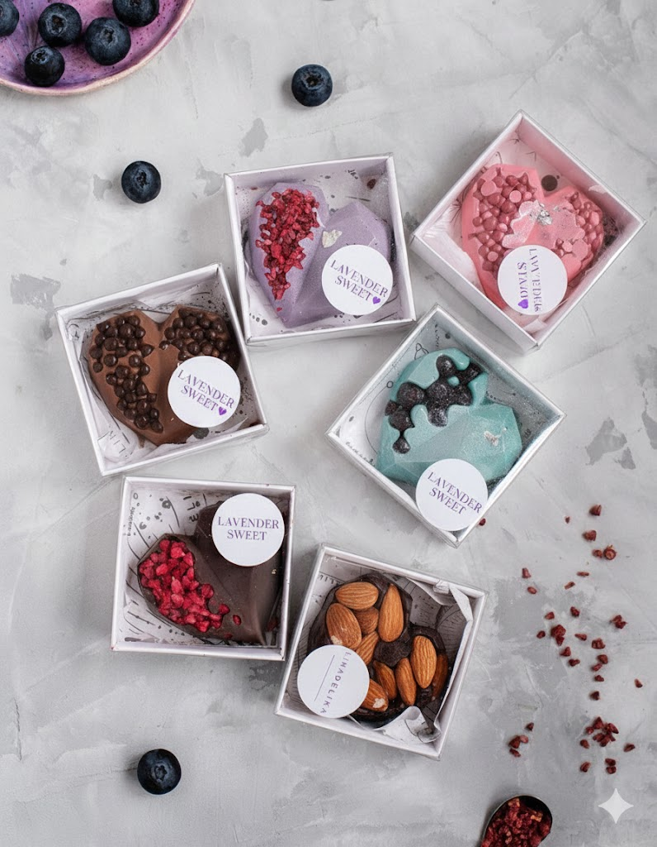
Website Features:
Home page with a soft, welcoming design
Product pages with clear details
Cart and checkout system
User login and registration
- Database System: Organized tables for users,
products, orders, and cart management.
-Goal: Create a smooth, beautiful shopping experience that feels calm and enjoyable.

Slide 7
Execution Strategy
Developing the back-end Connected the website to the database using PHP and added login, cart, and checkout features.
Creating the database Built tables for users, products, cart, and orders with organized relations.
Testing the system Checked product display, cart functions, and order process, then fixed issues.
Planning the idea Defined the project goal and main features.
Designing the interface Created a simple, soft design inspired by lavender colors.
Building the front-end Developed pages using HTML & CSS with clean layouts and smooth user experience.

Slide 8
“Project Development Process”
01
02
03
04
Planning the idea
Designing the interface
Building the website
Creating and organizing the database
Developed front-end pages with HTML & CSS and back-end features using PHP, including login, cart, and checkout.
Built tables for users, products, cart, and orders with organized relations, then tested the system and fixed issues.
Defined the project goal and main features.
Created a simple, soft design inspired by lavender colors.

Slide 9
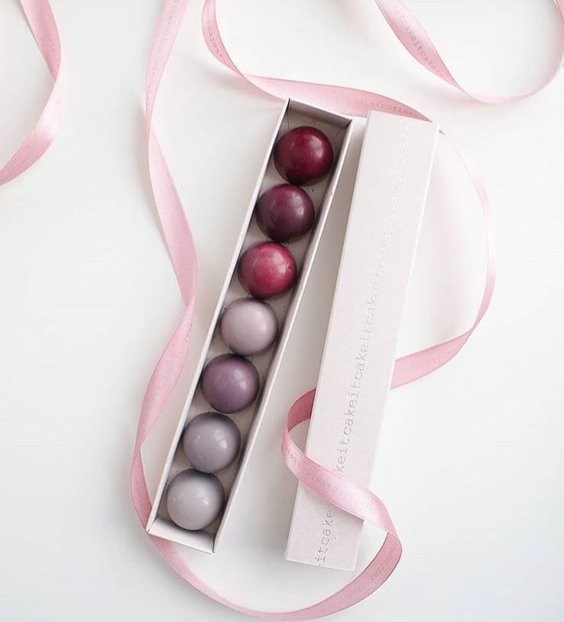
Challenges:
Displaying products in an organized and attractive way
Designing a user-friendly interface with soft colors
Connecting the website correctly to the database
Making the website responsive on all devices
Handling user login and data security

Slide 10
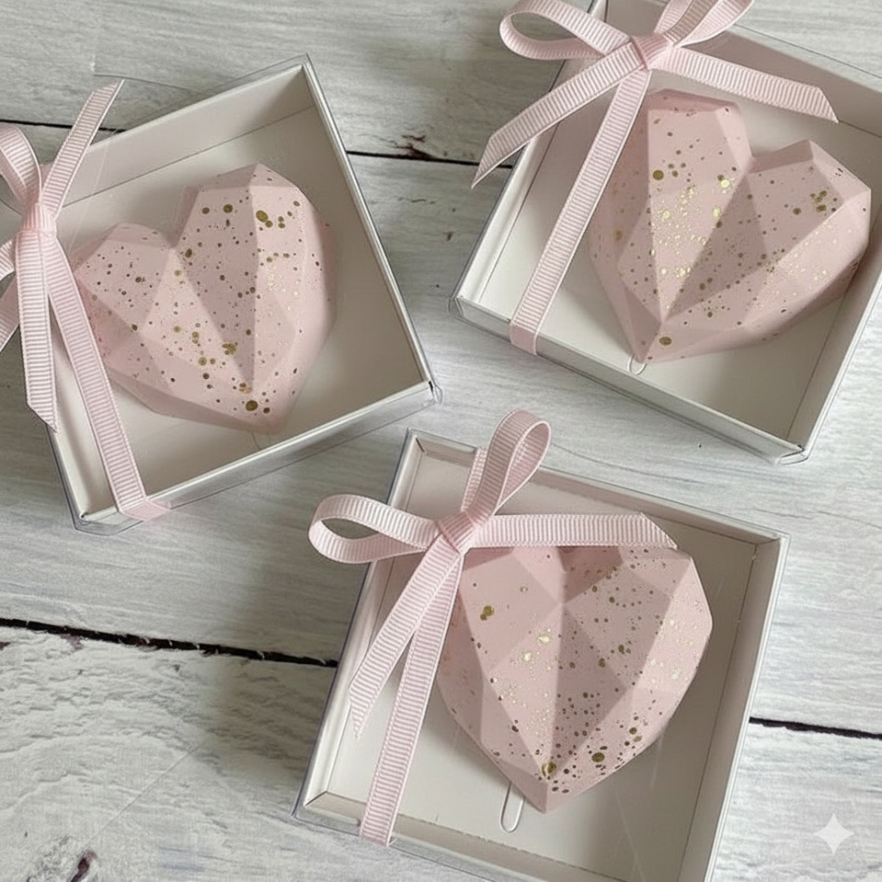
Solutions
Used Grid layout and CSS for product organization
Chose soft and matching colors for a pleasant experience
Created a well-structured database for products, users, and cart
Used CSS Media Queries for responsive design
Implemented sessions to secure user login and data

Slide 11
Conclusion
Lavender Sweet project demonstrates a complete and user-friendly e-commerce website.
We learned how to plan, design, and develop a real web project.
The website is visually appealing, functional, and responsive.
Future improvements can include more features and enhanced user experience.

Slide 12
Sara Othman Shehadi cs 123 web programming course

Slide 13
Thank You:
"Small details make a big difference."

